Slide 1
CPSC 5100
Nov 19 – Finding the Voice of the User

Slide 2
Analysis models
A picture is worth, well, a lot of words

Slide 3
Relating the customer’s voice to the model
Type of word | Examples | Analysis model components
Noun | People, organizations, software systems, data elements, existing objects | External entities, data stores, data flow diagrams Actors (use case diagrams) Entities or their attributes (ERDs) Lanes (swimlane diagrams) Objects with states (state transition diagrams)
Verb | Actions, things a user or system can do, or events that can occur | Processes (DFD) Process steps (swimlane diagrams) Use cases (use case diagrams) Relationships (ERD) Transitions (state transition diagrams) Activities (activity diagrams) Events (event-response tables)
Conditional / rule | Conditional logic statements, typically phrased if / then | Decisions (decision trees, tables, or activity diagram) Branching (swimlane or activity diagram)

Slide 4
An example
A chemist or a member of the chemical stockroom staff can place a request for one or more chemicals if the user is an authorized requester. The request can be fulfilled either by delivering a container of the chemical that is already in the chemical stockroom’s inventory or by placing an order for a new container of the chemical with an outside vendor. If the chemical is hazardous, the chemical can be delivered only if the user is trained. The person placing the request must be able to search vendor catalogs online for specific chemicals while preparing his request. The system needs to track the status of every chemical request from the time is is prepared until the request is either fulfilled or canceled. It also needs to track the history of every chemical container from the time is is received at the company until it is fully consumed or disposed of.

Slide 5
An example – nouns
A chemist or a member of the chemical stockroom staff can place a request for one or more chemicals if the user is an authorized requester. The request can be fulfilled either by delivering a container of the chemical that is already in the chemical stockroom’s inventory or by placing an order for a new container of the chemical with an outside vendor. If the chemical is hazardous, the chemical can be delivered only if the user is trained. The person placing the request must be able to search vendor catalogs online for specific chemicals while preparing his request. The system needs to track the status of every chemical request from the time is is prepared until the request is either fulfilled or canceled. It also needs to track the history of every chemical container from the time is is received at the company until it is fully consumed or disposed of.

Slide 6
An example – verbs
A chemist or a member of the chemical stockroom staff can place a request for one or more chemicals if the user is an authorized requester. The request can be fulfilled either by delivering a container of the chemical that is already in the chemical stockroom’s inventory or by placing an order for a new container of the chemical with an outside vendor. If the chemical is hazardous, the chemical can be delivered only if the user is trained. The person placing the request must be able to search vendor catalogs online for specific chemicals while preparing his request. The system needs to track the status of every chemical request from the time is is prepared until the request is either fulfilled or canceled. It also needs to track the history of every chemical container from the time is is received at the company until it is fully consumed or disposed of.

Slide 7
An example – rules
A chemist or a member of the chemical stockroom staff can place a request for one or more chemicals if the user is an authorized requester. The request can be fulfilled either by delivering a container of the chemical that is already in the chemical stockroom’s inventory or by placing an order for a new container of the chemical with an outside vendor. If the chemical is hazardous, the chemical can be delivered only if the user is trained. The person placing the request must be able to search vendor catalogs online for specific chemicals while preparing his request. The system needs to track the status of every chemical request from the time is is prepared until the request is either fulfilled or canceled. It also needs to track the history of every chemical container from the time is is received at the company until it is fully consumed or disposed of.

Slide 8
An example – the whole thing
A chemist or a member of the chemical stockroom staff can place a request for one or more chemicals if the user is an authorized requester. The request can be fulfilled either by delivering a container of the chemical that is already in the chemical stockroom’s inventory or by placing an order for a new container of the chemical with an outside vendor. If the chemical is hazardous, the chemical can be delivered only if the user is trained. The person placing the request must be able to search vendor catalogs online for specific chemicals while preparing his request. The system needs to track the status of every chemical request from the time is is prepared until the request is either fulfilled or canceled. It also needs to track the history of every chemical container from the time is is received at the company until it is fully consumed or disposed of.

Slide 9
Choosing an appropriate representation
Information depicted | Representation technique
System external interfaces | Context and use case diagrams, data flow diagrams, ecosystem maps File formats, report layouts, interface specifications (h/w and s/w)
Business process flows | Data flow diagrams, swimlane diagrams Flowcharts and activity diagrams
Data definitions and data relationships | Entity-relationship diagram, class diagrams Data dictionary
System and object states | State transition diagrams and state tables Event-response tables Functional requirements
Complex logic | Decision trees and decision tables Pseudocode
User interfaces | Dialog maps Storyboards, low-fidelity prototypes, display-action-response diagrams Detailed screen layouts, high-fidelity prototypes, data field definitions, UI control descriptions
User task descriptions | User stories, scenarios, and use case specifications Swimlane diagrams, flowcharts, activity diagrams Functional requirements, test cases
Nonfunctional requirements | Natural language text Planguage or other formal requirements language

Slide 10
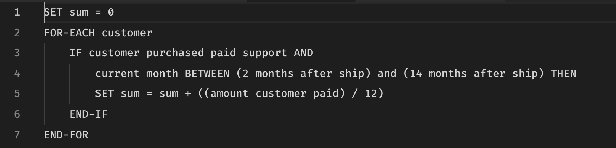
Pseudocode

Slide 11
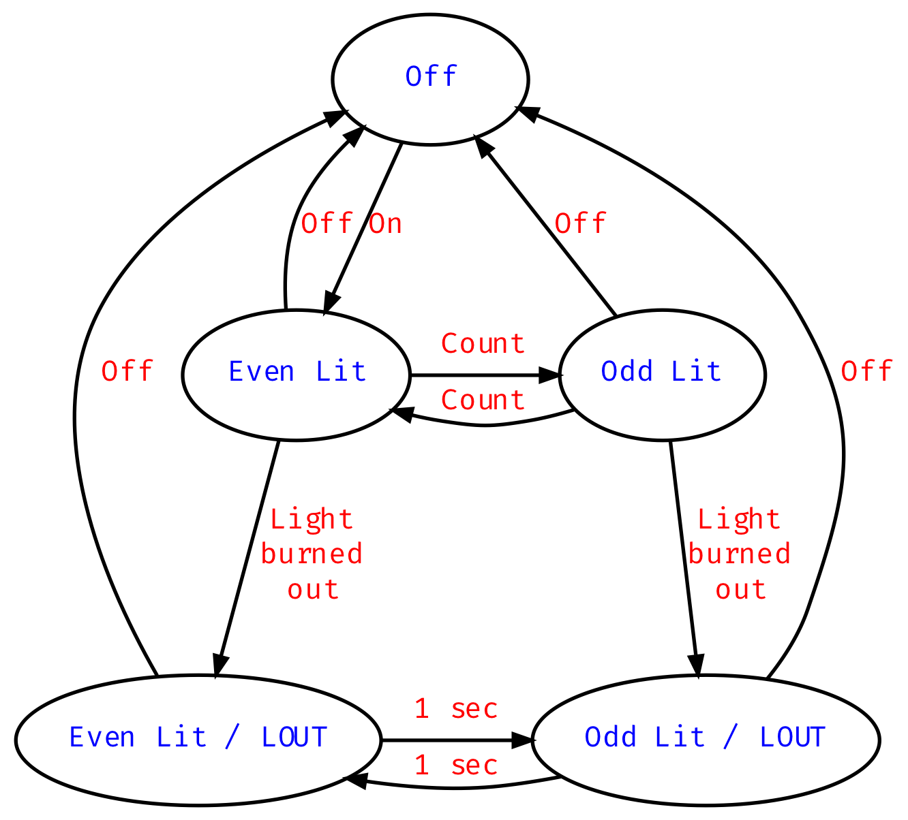
State transition diagrams
After On is pushed but before Off is pushed, the system is termed “powered on”
After Off is pushed but before On is pushed, the system is termed “powered off” and no lights shall be lit
Since the most recent On press, if Count has been pressed an odd number of times, Odd shall be lit
Since the most recent On press, if Count has been pressed an even number of times, Even shall be lit
If either light burns out, the other light shall flash every one second

Slide 12
State transition matrix
 | Event
State | On press | Off press | Count press | Bulb burns out | Every second | Output
Off | Even Lit | -- | -- | -- | -- | Both off
Even Lit | -- | Off | Odd Lit | Light out / Even Lit | -- | Even Lit
Odd Lit | -- | Off | Even Lit | Light out / Odd Lit | -- | Odd Lit
Light out / Even Lit | -- | Off | -- | Off | Light out / Odd Lit | Even Lit
Light out / Odd Lit | -- | Off | -- | Off | Light out / Even Lit | Odd Lit

Slide 13
Decision table
 |  | Rules
Conditions | Printer does not respond | Y | Y | Y | Y | N | N | N | N
 | A red light is flashing | Y | Y | N | N | Y | Y | N | N
 | Print is unrecognized | Y | N | Y | N | Y | N | Y | N
Actions | Check the power cable |  |  | ✗
 | Check the printer-computer connection | ✗ |  | ✗
 | Ensure printer software is installed | ✗ |  | ✗ |  | ✗ |  | ✗
 | Check / replace link | ✗ | ✗ |  |  | ✗ | ✗
 | Check for paper jam |  | ✗ |  | ✗

Slide 14
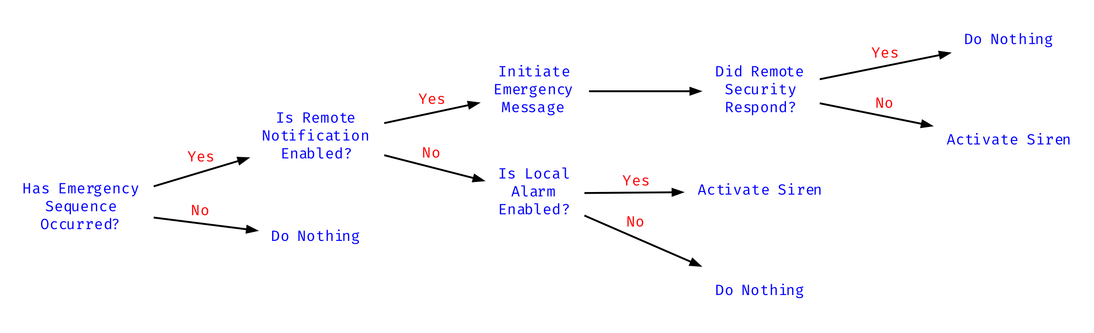
Graphical decision tree

Slide 15
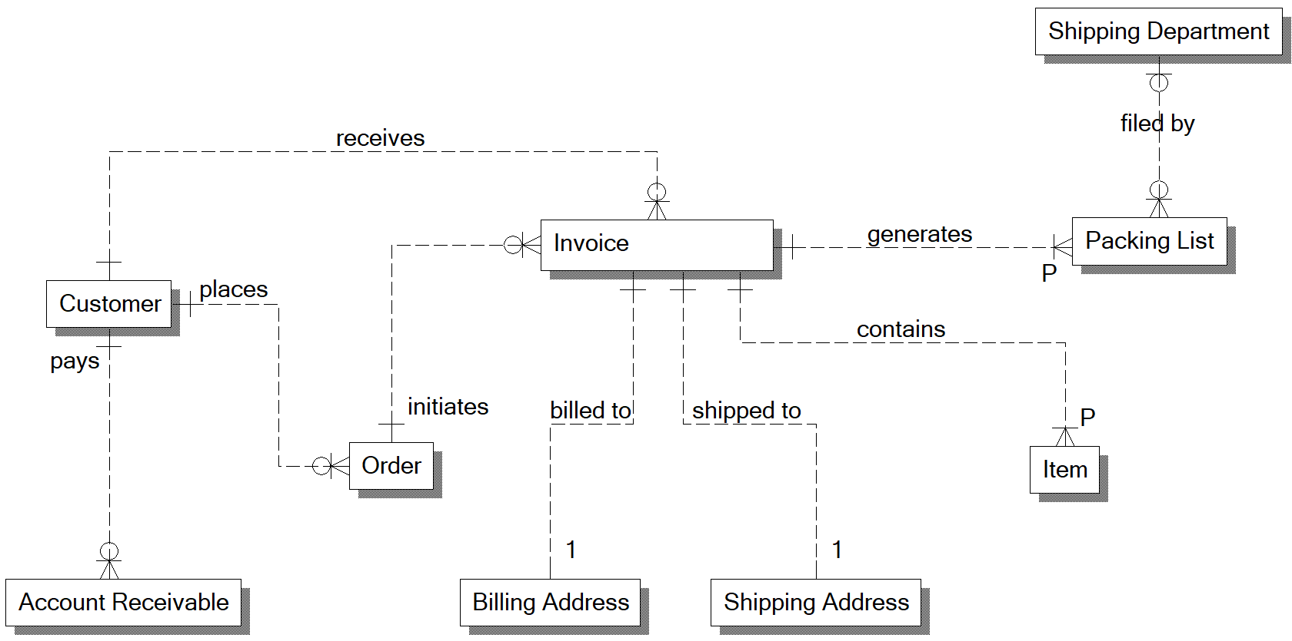
Entity-Relationship models

Slide 16
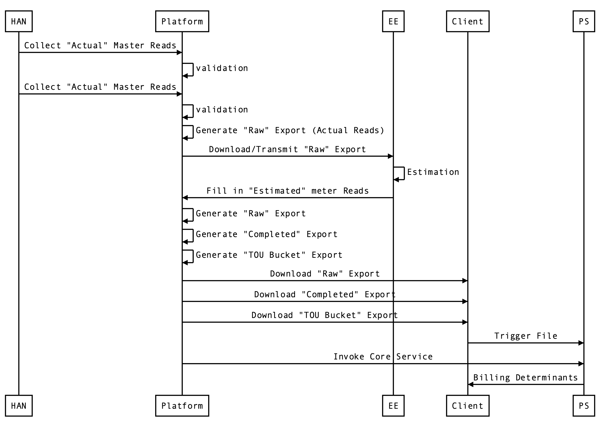
Sequence diagrams

Slide 17
Our customers
More about stakeholders, users, and experiences

Slide 18
Two classes of stakeholders
System stakeholders are anyone who
Directly uses the system
Works with the results of those who use the system
Will be impacted by the deployment or operation of the system
Project stakeholders are anyone who
Has a vested interest in the budget and schedule
Has a vested interest in understand how the whatsit will be developed
Will be involved in marketing, selling, installing, or maintaining the whatsit

Slide 19
Levels of involvement
They should be kept informed
These people have a need to know, but no real decision-making ability
They should be consulted
These people should be involved in their area of expertise
They are partners in development
These people are impacted by your development needs and decisions
They are in control of outcomes
These are the decision makers, funders, and users

Slide 20
More about expectations
Timely decisions are needed (really, they’re necessary)
Active participation is needed (see above)
Teams must take an enterprise / higher-level view
Production and support should be involved (really) early
Plan for maintenance and releases

Slide 21
Identify project stakeholders
Who needs to be consulted on project scope?
Who has input to the budget and schedule?
Who manages the business relationship between team and customer?
Who determines how and when the system is released?
Who can support or harm the project politically?
What partners are dependent on our system?
Who cares about the process used to develop the system?

Slide 22
Identifying system stakeholders
Who will directly use the system?
Who will be using the results of those who use the system?
Who will be responsible for supporting the system?
What other systems will our system interact with?
What (system) interfaces must it provide?
Who can provide functional guidance and system qualities?

Slide 23
Thinking about personas
Don’t make up your personas
Discover them through requirements analysis
Develop a specific, individual persona
In fact, there’s no reason this shouldn’t be a real person
Design your system for that individual
This person represents your primary persona
Others will bend and stretch to use your system
But, make sure your system can bend and stretch
There shouldn’t be that many personas
If there are, you’re too fine-grained and need to decompose the solution

Slide 24
User interface design
A couple of short videos

Slide 25
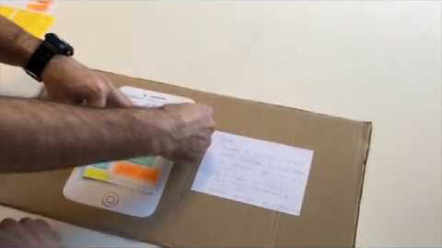
US design – paper based prototype testing

Slide 26
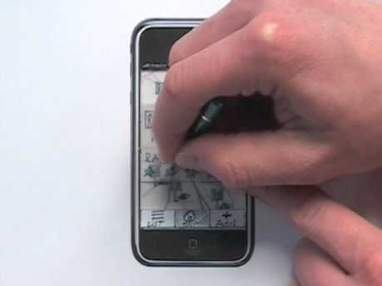
Bill Buxton – Paper prototyping

Slide 27
For next time
Read (for Wednesday):
Developers can learn ¾ of Design (http://fivesketches.com/tag/bill-buxton/)
https://www.interaction-design.org/literature/article/stage-4-in-the-design-thinking-process-prototype
http://www.billbuxton.com/rightDesign.pdf
Leffingwell chapter 17 (we’ll cover Wednesday)
Homework assignment #3 (see assignments/ASSIGN-3.md)
For Monday 3 December

